Slide 1
CSS 343: Data Structures, Algorithms, and Discrete Mathematics II
Tree Introduction
Version 2
Wooyoung Kim

Slide 2
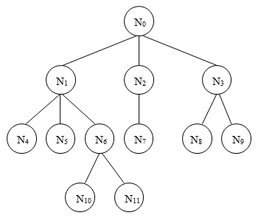
Terms
Node
Branch (edge)
Parent, child, siblings
Ancestor, descendant
Height (many definitions): maximal level of any node
If root as level 0, height of this tree: 3
If root as level 1, height of this tree: 4
Can be defined using a recursive definition.
T is a tree if:
T is empty, or
T has a node and zero or more non-empty subtrees (each of which is also a tree.)

Slide 3
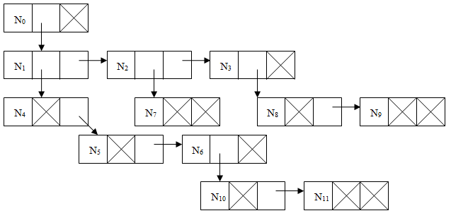
General Tree Implementation
Each node can have any number of children
Use the first-child, next-sibling representation
Any application using general tree?

Slide 4
Binary Tree
At most 2 children
struct BinaryTreeNode {
Object *item;
BinaryTreeNode *leftChild;
BinaryTreeNode *rightChild;
};
Many uses
Expression tree
Huffman coding algorithm
Binary search tree
etc.
Will include a binary tree implementation in assignment 2

Slide 5
Full, Complete, and Balanced Binary Trees
Full binary tree has no nodes with one child; they all have zero or two.
Perfect binary tree: full binary tree where all of the leaves are at the same level
Complete binary tree has every level, except possibly the deepest, is completely filled. The nodes in the last level are as far left as possible
Balanced binary tree: where the left and right subtrees of any node have height difference by at most 1
Notes:
A binary tree has a maximum of two children per node. A full binary tree has no nodes with one child; they all have zero or two. A perfect binary tree is a full binary tree where all of the leaves are at the same level (although this is sometimes called a complete binary tree, we will use a different definition). A complete binary tree has every level, except possibly the deepest, is completely filled. The nodes in the last level are as far left as possible.
Full binary tree:

Slide 6
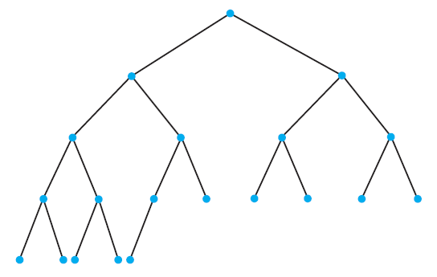
Full, Complete, and Balanced Binary Trees -- 1
https://pollev.com/wooyoungkim019
Is it full? Complete? Balanced?
Notes:
A binary tree has a maximum of two children per node. A full binary tree has no nodes with one child; they all have zero or two. A perfect binary tree is a full binary tree where all of the leaves are at the same level (although this is sometimes called a complete binary tree, we will use a different definition). A complete binary tree has every level, except possibly the deepest, is completely filled. The nodes in the last level are as far left as possible.
Every complete binary tree is balanced but not the other way around.
Complete and balanced

Slide 7
Full, Complete, and Balanced Binary Trees --2
https://pollev.com/wooyoungkim019
Is it full? Complete? Balanced?
Notes:
A binary tree has a maximum of two children per node. A full binary tree has no nodes with one child; they all have zero or two. A perfect binary tree is a full binary tree where all of the leaves are at the same level (although this is sometimes called a complete binary tree, we will use a different definition). A complete binary tree has every level, except possibly the deepest, is completely filled. The nodes in the last level are as far left as possible.
Every complete binary tree is balanced but not the other way around.
Full, balanced but not complete

Slide 8
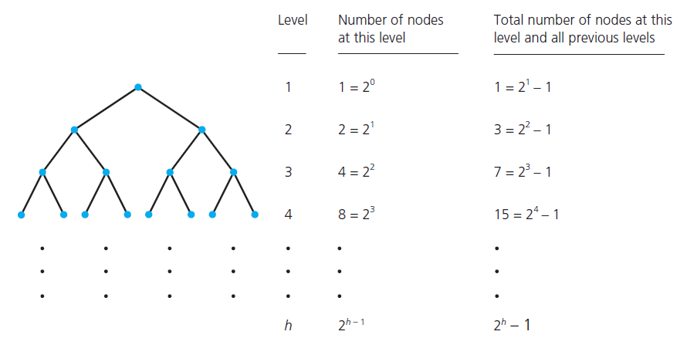
The Maximum and Minimum Heights of a Binary Tree

Slide 9
Binary tree – array implementation(1)
Array size of a tree with height h: 2^{h}
Store the root at index 0
Children of a node at position i at positions 2i+1 and 2i+2.
Index j’s parent index is (j-1)/2

Slide 10
Binary tree – array implementation(2)

Slide 11
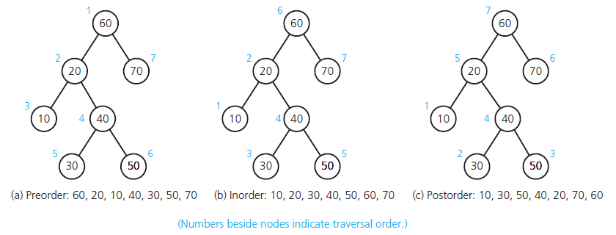
Traversals of a Binary Tree
Can you implement?

Slide 12
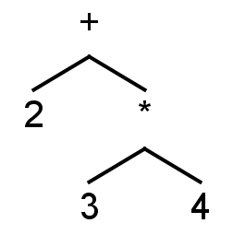
Expression tree
Solving binary (mathematical) expression
Binary (unary) operator: internal node
Operands: leaf node
E.g., compiler does it
Example
2 + 3 * 4
How about (2+3) * 4
Idea? Substitute: X*4
How about - Practice
5 * ( (3 * 4) + (6 / 2 ) – (8 + 2) )

Slide 13
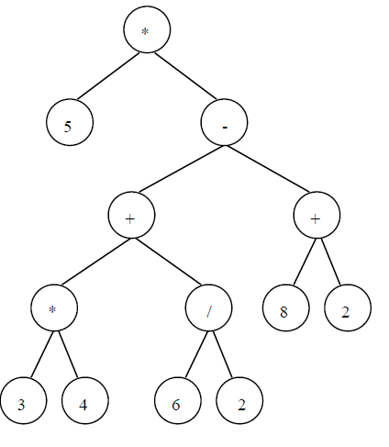
Expression tree
Prefix:
Postfix:
Infix:

Slide 14
Exercise Expression tree
A – (B + C * D) / E
Build an expression tree
Prefix expression
Postfix expression
Infix expression
https://pollev.com/wooyoungkim019

Slide 15
Evaluate Postfix
A – (B + C * D) / E = A B C D * + E / -
Evaluate it when A=8, B=7, C=4, D=5, E = 9
Infix: 8-(7+4*5)/9 = 5
PostFix: 8 7 4 5 * + 9 / -
c | Operation | stack
8
7
4
5
*
+
9
/
-

Slide 16
Evaluate Postfix
A – (B + C * D) / E = A B C D * + E / -
Evaluate it when A=8, B=7, C=4, D=5, E = 9
Infix: 8-(7+4*5)/9 = 5
PostFix: 8 7 4 5 * + 9 / -
c | Operation | stack
8 | Push | 8
7 | Push | 8 7
4 | Push | 8 7 4
5 | Push | 8 7 4 5
* | Pop 5 and 4, push 4*5 | 8 7 20
+ | Pop 20, 7, push 7+20 | 8 27
9 | Push | 8 27 9
/ | Pop 9, 27, push 27/9 | 8 3
- | Pop 3, 8, push 8-3 = 5 | 5

Slide 17
More Exercise
Carrano, Chapter 15:
Exercises: #4, #22
Write a method to traverse a tree (inorder, preorder, postorder)
Write a method to sum the elements in a binary tree
Write a method to count the number of nodes with exactly one child
Trace “countLeaves” in lecture note 1, using box-tracing method

Slide 18
Huffman coding
Used in compression (e.g., text document)
Observations
Some characters (e.g., ‘e’, ‘o’,) appear more often than others (‘q’, ‘z’)
Ideas?
Fewer bits for symbols appearing frequently
Possibility of ambiguity if you don’t do it right
So Huffman coding to the rescue!
https://www.techiedelight.com/huffman-coding/

Slide 19
Algorithm (one version)
Each letter is a small tree with a single node (and has an associated weight - the frequency)
Repeat until all nodes form a single tree (normally put smaller on left):
Select the two trees with the smallest weights.
Merge these trees into a new tree by adding a node that is the parent of both.
The weight of the new tree is the sum of the weights of the two previous trees.
Assign a 0 to one branch (normally left) of the tree and a 1 to the other branch (normally right) of the tree.
E.g. e (22); a (20); r (15); s (18); p (19)

Slide 20
Document (input): eeeeeeeeeeeeeeeeeeeeeeaaaaaaaaaaaaaaaaaaaarrrrrrrrrrrrrrrssssssssssssssssssppppppppppppppppppp

Slide 21
Get frequencies of each letter
e (22); a (20); r (15); s (18); p (19)
Tree:
Strategy:
Sort
Remove two letters of smallest frequency, put them as children. Add new letter (combined) with the sum of frequencies
Repeat 1 & 2 until all letters are removed
Note: When put them in a tree, put small frequency as a left child

Slide 22
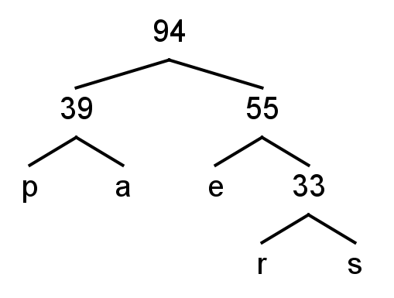
e (22); a (20); r (15); s (18); p (19)
Tree:
What is 1111001
0
1
0
1
0
1
0
1
https://pollev.com/wooyoungkim019

Slide 23
Exercise
A (20); E (32); L (14); I (11); M (16); O (12); S (7); T (3) – draw tree and then list code for each character

Slide 24
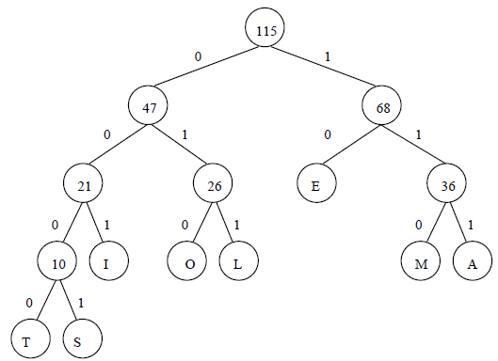
Exercise
A (20); E (32); L (14); I (11); M (16); O (12); S (7); T (3) – draw tree and then list code for each character

Slide 25
Huffman encoding efficiency
Take home question.
Hint: The time will depend on what data structure you will use when implementing the algorithm

Slide 26
Binary Search Tree
Ordered collection of items
Greater than all the values in its left subtree and less than all the values in its right subtree,
equal can be put on the left or right or discarded
Build a binary search tree
18 3 37 11 25 21 40 8 13 1 42 15
https://www.cs.usfca.edu/~galles/visualization/Algorithms.html

Slide 27
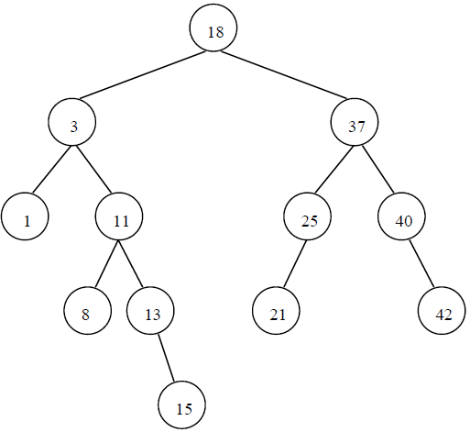
Binary Search Tree
Ordered collection of items
Greater than all of the values in its left subtree and less than all of the values in its right subtree,
equal can be put on the left or right or discarded
Build a binary search tree
18 3 37 11 25 21 40 8 13 1 42 15

Slide 28
Programming a BST – Retrieve, Insert
const Object * retrieve(BinaryTreeNode *root, const Object &key) {
if (root == NULL) return NULL;
else if (key == *root->item) return root->item;
else if (key < *root->item) return retrieve(root->leftChild, key);
else return retrieve(root->rightChild, key); }
void insert(BinaryTreeNode *&root, Object *item) {
if (root == NULL) {
root = new BinaryTreeNode;
root->item = item;
root->leftChild = NULL;
root->rightChild = NULL; }
else if (*item < *root->item) insert(root->leftChild, item);
else insert(root->rightChild, item); }
Assumption: drop duplicate values

Slide 29
How about delete p – group practice
First find, then delete
Possible node position
Leaf, no children (e.g., 1)
Only left child (e.g., 25)
Only right child (e.g., 13)
Two children - A little trickier (e.g., 18)
Need to find a replacement for it
Either largest descendant of the left child
OR smallest descendant of the right child (USE THIS in your practice)

Slide 30
How about delete p – group practice
write pseudo-code
bool deleteNode(BinaryTreeNode *&root, const TreeData &item)
{
if (root == NULL) return false;
else if (item == *root->item) {
deleteRoot(root);
return true;
}
else if (item < *root->item) return deleteNode(root->leftChild, item);
else return deleteNode(root->rightChild, item);
}

Slide 31
BST efficiency
If not a balanced tree with n nodes
Insertion:
Deletion:
Retrieval:
If complete and balanced tree with n nodes
Insertion:
Deletion:
Retrieval:

Slide 32
BST efficiency
If not a balanced tree with n nodes
Insertion:
Deletion:
Retrieval:
If complete and balanced tree with n nodes
Insertion:
Deletion:
Retrieval:
O(n)
O(logn)

